Slide 1
2019 Annual Meeting
Nashville, TN
October 2019

Slide 2
CWG: Cannabis Legislative Update

Slide 3
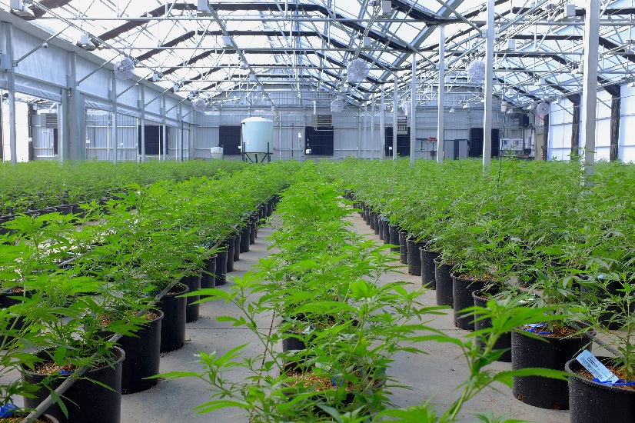
D.C. and 10 states allow recreational marijuana use
More than 30 states have authorized medical marijuana or cannabis with low THC content
Proponents say legalization will raise tax revenue, aid patients, reduce prison population
Marijuana is the most commonly used illicit drug in the U.S.
About 9.6 percent of people aged 12 or older said they used marijuana within the past month in 2017, up from 6.1 percent in 2008
Use among young people age 12 to 17 stayed relatively flat during that period

Slide 4
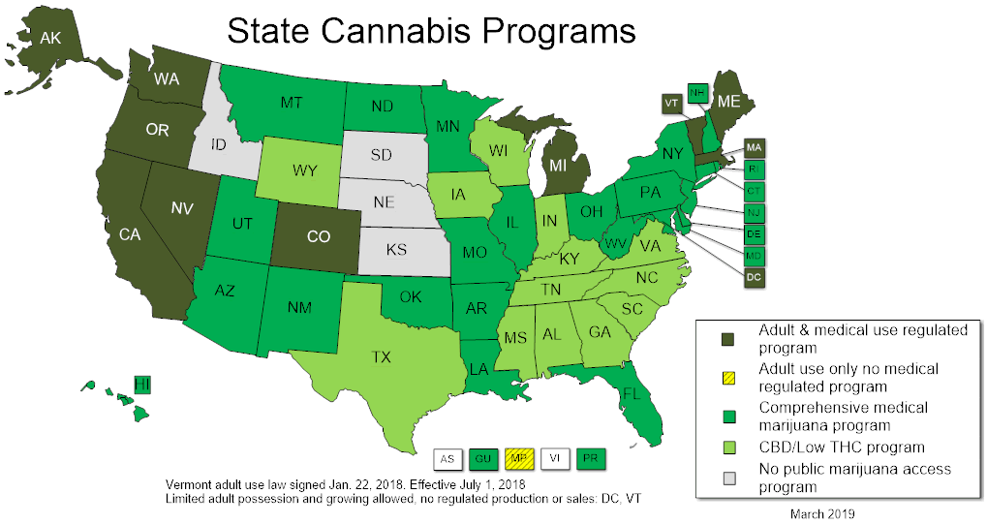
Cannabis Programs in Almost Every State

Slide 5
Marijuana outlawed in 1970 Controlled Substances Act
Labeled as Schedule I substance with high potential for abuse, no accepted medical use
Criminal penalties for growing, trafficking, and possessing
Federal law enforcement usually focuses on marijuana traffickers and distributors; arrests for possession mostly made by state and local police
Barack Obama’s Justice Department outlined targeted enforcement for marijuana cases involving minors, criminal enterprises, violence, drugged driving, and public lands
Department would not enforce federal ban in states with well-regulated system for legalized marijuana, unless there was a high-priority offense
Former Attorney General Jeff Sessions rescinded the Obama-era memo
President Donald Trump said he’ll leave marijuana regulation up to states
Long-standing appropriations rider says Justice Department cannot stop states from implementing medical marijuana laws
Federal Law
Still Criminalizes Marijuana

Slide 6
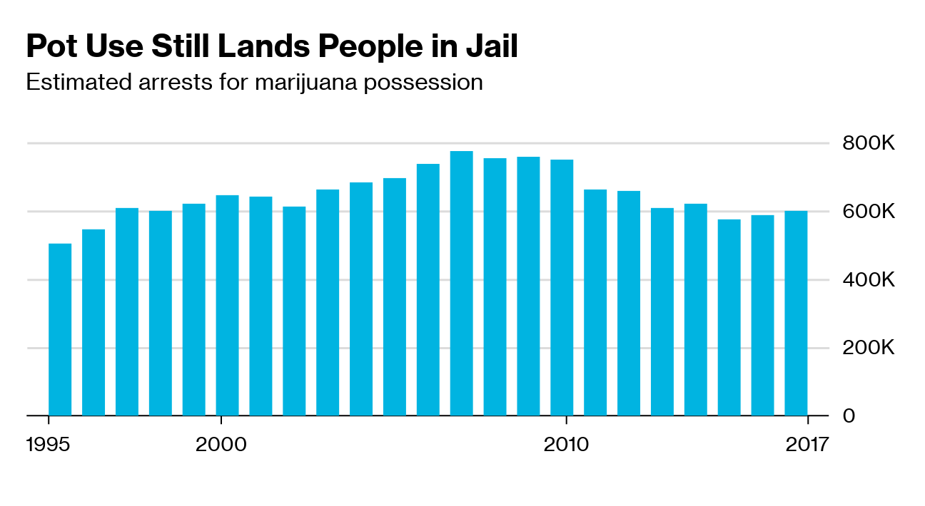
About 600,000 arrests for possession in 2017; slight uptick in past three years

Slide 7
End of Federal Criminalization
The DEA and FDA are authorized to reschedule marijuana but have declined to do so
Most recent denial was in 2016; the White House is reviewing a petition to reschedule
The FDA sought comments on draft White House proposal to ease international treaty controls

Slide 8
End of Federal Criminalization
H.R. 1120 and S. 420 from Rep. Blumenauer (D-OR) and Sen. Wyden (D-OR), and H.R. 420 from Blumenauer, would legalize marijuana by descheduling it and:
Set up a Treasury Department licensing system for pot businesses
Make it a federal crime to transport marijuana into a place in violation of state or local laws, allowing for state-level regulation, even prohibition, of marijuana
Assign marijuana authorities to Treasury and Justice department agencies that regulate alcohol and tobacco manufacturing and trade practices

Slide 9
End of Federal Criminalization
H.R. 1119 and S. 421 from Blumenauer and Wyden would transfer marijuana regulatory responsibility to the states
Would also allow state-licensed sellers to claim tax credits, set up a process to expunge marijuana-related convictions, and create protection for banks serving marijuana businesses
Would prevent misdemeanor crimes from disqualifying people from accessing student aid

Slide 10
ACIL Supports STATES Act
ISSUES OF CONCERN:
As states began developing their own approaches to marijuana enforcement the Department of Justice issued guidance to support these state actions and focus law enforcement resources; the Cole Memorandum of 2013.
However, this guidance was withdrawn in 2018, causing legal uncertainty that severely limits these state laboratories of democracy, creates public health and safety issues, and undermines the state regulatory regimes.
Sens. Gardner (R-CO) and Warren (D-MA)
Reps. Blumenauer (D-OR) and Joyce (R-OH)

Slide 11
ACIL Supports STATES Act
On April 4, 2019, the STATES Act (S. 1028, H.R. 2093) was reintroduced in the U.S. Senate by Sens. Gardner (R-CO) and Warren (D-MA) and in the House by Reps. Blumenauer (D-OR) and Joyce (R-OH).
This legislation mirrors the intend of the 2013 Cole Memorandum.
Sens. Gardner (R-CO) and Warren (D-MA)
Reps. Blumenauer (D-OR) and Joyce (R-OH)

Slide 12
ACIL Supports STATES Act
Strengthening the Tenth Amendment Through Entrusting States (STATES) Act ensures that each State has the right to determine for itself the best approach to marijuana within its borders.
The bill extends these protections to Washington D.C, U.S. territories, and federally recognized tribes, and contains common-sense guardrails to ensure that states, territories, and tribes regulating marijuana do so in a manner that is safe and respectful of the impacts on their neighbors.
Sens. Gardner (R-CO) and Warren (D-MA)
Reps. Blumenauer (D-OR) and Joyce (R-OH)

Slide 13
ACIL Supports STATES Act
The bill largely mirrors the STATES Act introduced in the last Congress with two exceptions:
The provisions legalizing hemp have been eliminated as those provisions are no longer necessary due to the 2018 Farm Bill; and
The STATES Act includes a provision requiring the U.S. Government Accountability Office to provide a report on traffic safety issues, including the collection of data regarding traffic crashes and injuries in states which have legalized marijuana and possible evaluation of the relationship of marijuana impairment with such incidents.
Sens. Gardner (R-CO) and Warren (D-MA)
Reps. Blumenauer (D-OR) and Joyce (R-OH)

Slide 14
STATES Act
The STATES Act is likely to encounter opposition from conservatives who view the bill as a step towards legalization – though the bill does not legalize cannabis nor make any normative statements about cannabis use.
There are also significant concerns being raised by progressives who claim that the bill does not go far enough, and are calling for the STATES Act to include the expungement of federal cannabis crimes or other social justice provisions that can be addressed within the jurisdiction of the Judiciary Committees.
The Minority Cannabis Business Association opposes the STATES Act because it does not include elements that address minority access or social justice issues related to cannabis.
Issues of Concern

Slide 15
STATES Act
Proponents of the STATES Act see it as an important step in eliminating the current conflict between federal law and state laws concerning the legalizations of cannabis, while marijuana advocates are framing the bill as the first step in ending federal prohibition of cannabis.
Many conservatives opposed to loosening any federal drug laws oppose the STATES Act because they see it as a “slippery slope” leading directly to legalization.
Issues of Concern

Slide 16
Medical Marijuana
Marijuana used for various medical conditions, including pain, nausea, and epilepsy
Annual spending rider bars federal interference with state medical marijuana laws
FDA has not approved marijuana for medical use at federal level and has said there isn’t enough evidence to demonstrate safety and efficacy
Legalization opponents point to FDA stances that there’s no medical benefit and can cause harm
116th Congress

Slide 17
Medical Marijuana
Advocates say federal regulation impedes marijuana research, clinical trials
As Schedule I drug, researchers must obtain separate DEA registration and manufacturers are subject to production quotas, among other requirements
There is also only one approved manufacturer under contract with NIDA; some say product is insufficient and subpar
116th Congress

Slide 18
Medical Marijuana Research
The Cannabidiol and Marijuana Research Expansion Act (S. 2032)
Sens Feinstein (D-CA), Grassley (R-IA), and Schatz (D-HI), Alexander (R-TN), Durbin (D-IL), Klobuchar (D-MN), Tillis (R-NC), Kaine (D-VA), Ernst (R-KS), Cramer (R-ND), and Tester (D-MT).
Sen. Schatz sent NIH and FDA a letter asking about their ongoing efforts to prioritize research for medical cannabis.
In essence, the response signals that both agencies support this research bill.
ACIL Supports S. 2032

Slide 19
Cannabis Banking Issues
Federal ban means banks and credit unions can face penalties for working with cannabis companies, despite booming business in legalized states
One analyst said annual marijuana sales could grow to $80 billion by 2030
Bipartisan bill (H.R. 1595) would shield banks from federal regulators and enforcement if they provide services to a state-approved cannabis business

Slide 20
Banking Issues
Measure is intended to expand banking access for pot dispensaries and growers, as well as service providers such as landlords, lawyers, and accountants
Future of cannabis banking remains uncertain
Senate Banking Chairman Mike Crapo (R-Idaho), who represents one of the few states without a cannabis program, has not taken a stance
Some banks said they still will not work with pot businesses without federal legalization
Cannabis

Slide 21
More Than a Dozen Committees Share the Issue
Overlapping jurisdiction complicates the path forward for larger bills
Committees | Issue areas
House and Senate Judiciary | Drug scheduling, criminal code, Justice Department/DEA, federalism/state issues
House Homeland Security and Senate Homeland Security and Governmental Affairs | Drug trafficking
House Financial Services and Senate Banking, Housing, and Urban Affairs | Banking services for marijuana businesses
House Energy and Commerce and Senate Health, Education, Labor, and Pensions | Medical research, HHS/FDA
Senate Commerce, Science, and Transportation | Marijuana research and consumer regulation
House Agriculture and Senate Agriculture, Nutrition, and Forestry | Crops and agricultural research
House and Senate Veterans’ Affairs | Medical marijuana for veterans
House Foreign Affairs and Senate Foreign Relations | International flow of illicit narcotics
House Ways and Means and Senate Finance | Marijuana taxation

Slide 22
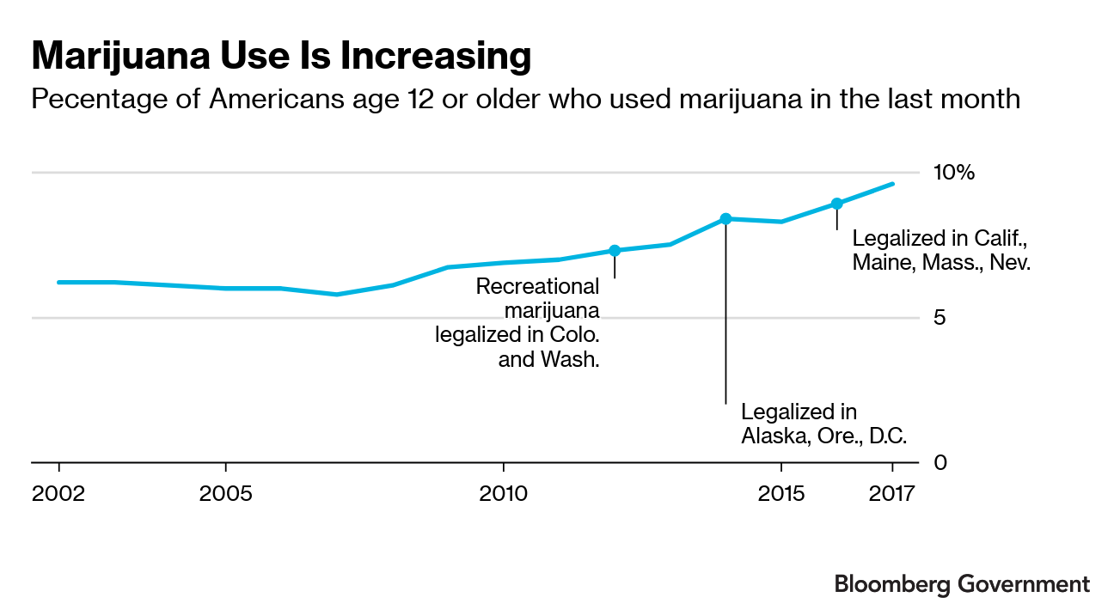
Legalization could increase marijuana use, but could decrease consumption and excise tax revenue from other products such as alcohol

Slide 23
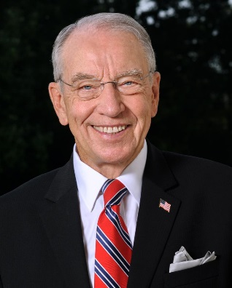
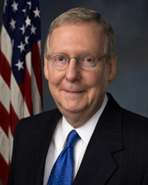
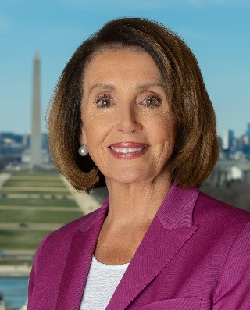
What’s Next For Legalization in Congress
Some measures could reach the House Floor, Senate approach is unclear
With many committees sharing oversight, an omnibus marijuana bill could be difficult to pass
Finance Committee Chairman Grassley (R-IA) praised White House move to rescind the Obama administration's approach
Senate Judiciary Chairman Graham (R-SC) has expressed openness to medical use, though not recreational
Senate Majority Leader McConnell (R-KY) supports hemp legalization, hasn’t backed broader marijuana legalization
Speaker Nancy Pelosi (D-Calif.) said path forward depends on the White House position
President Trump expressed support for previous version of Warren-Gardner bill, S. 3032 in the 115th Congress
Graham
Grassley
McConnell
Pelosi
Sources: ”Sen. Chuck Grassley talks DACA, marijuana and more in Council Bluffs,” Omaha-World Herald; Senate Judiciary Committee Hearing Transcript; “Farm Bill With Small Tweaks on Food Aid Headed For Floor Votes,” Bloomberg Government.

Slide 24
Thank You Questions or Concerns?

