Slide 1
Process improvement for the lab
Leveraging LEAN principles to drive Efficiencies and Productivity

Slide 2
overview
Group Exercise
LEAN principles overview
Case Studies In-lab perspective
Q&A

Slide 3
Exercise
At your tables discuss your experiences in driving greater process improvement.
What have you tried?
What’s worked?
What’s failed?

Slide 4
Process improvement for the lab
PROCESS IMPROVEMENT

Slide 5
LEAN defined
The Lean methodology relies on 3 very simple ideas:
deliver value from your customer’s perspective
eliminate waste (things that don’t bring value to the end product)
continuous improvement

Slide 6
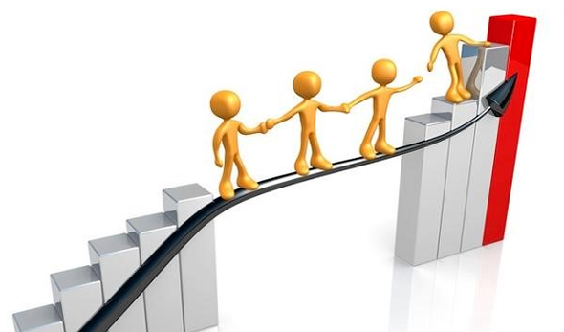
Benefits of LEAN Management
Better use of resources
Smarter process
Improving productivity & efficiency
Focus
Notes:
Focus. By applying Lean, you will be able to reduce waste activities. Therefore, your workforce will be focused on activities that bring value.
Improving productivity & efficiency. When employees are focused on delivering value, they will be more productive and efficient, because they won’t be distracted by unclear tasks.
Smarter process (pull system). By establishing a pull system, you will able to deliver work only if there is actual demand. Which leads to the next one.
Better use of resources. When your production is based on actual demand, you will be able to use only as many resources as needed.

Slide 7
The 5 Basic LEAN Principles

Slide 8
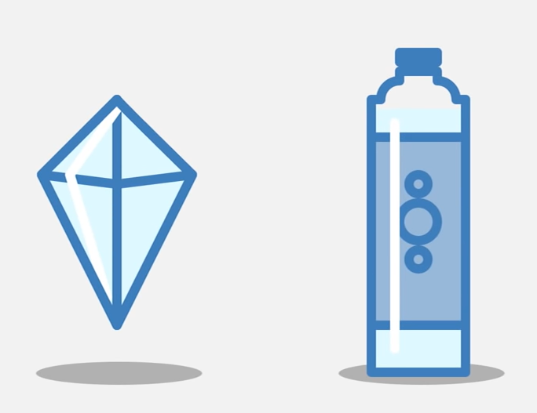
Identify Value
The Paradox Of Value

Slide 9
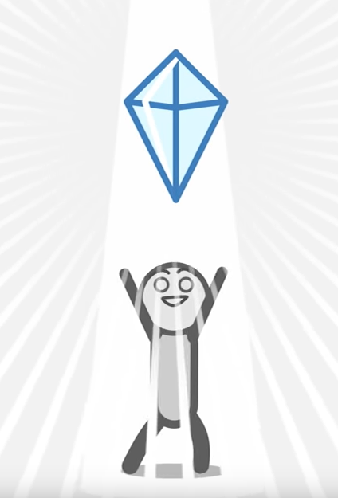

Slide 10
Day 4

Slide 11
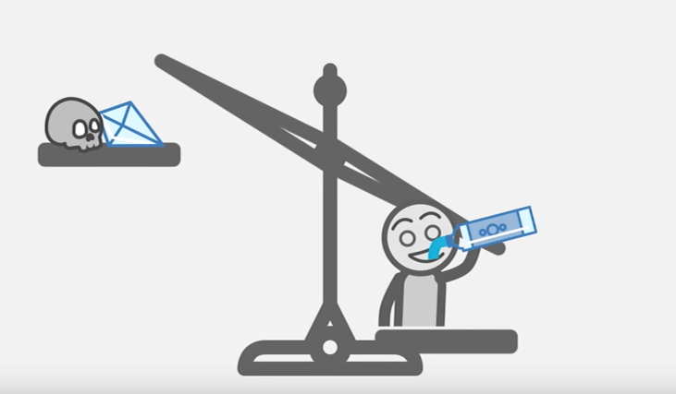
Exchange Value VS. Use Value

Slide 12
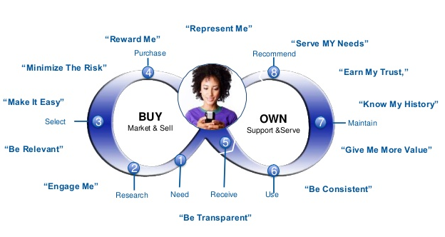
Identify Value
Notes:
What does every company strive to do? To offer a product/service that a customer is ready to pay for. To do so, a company needs to add value defined by its customers’ needs.
The value lies in the problem you are trying to solve for the customer. More specifically in the part of the solution that your customer is actively willing to pay. Any other activity or process that doesn’t bring value to the end product is considered waste.
So you first need to identify the value that you want to deliver and then proceed to the next step.

Slide 13
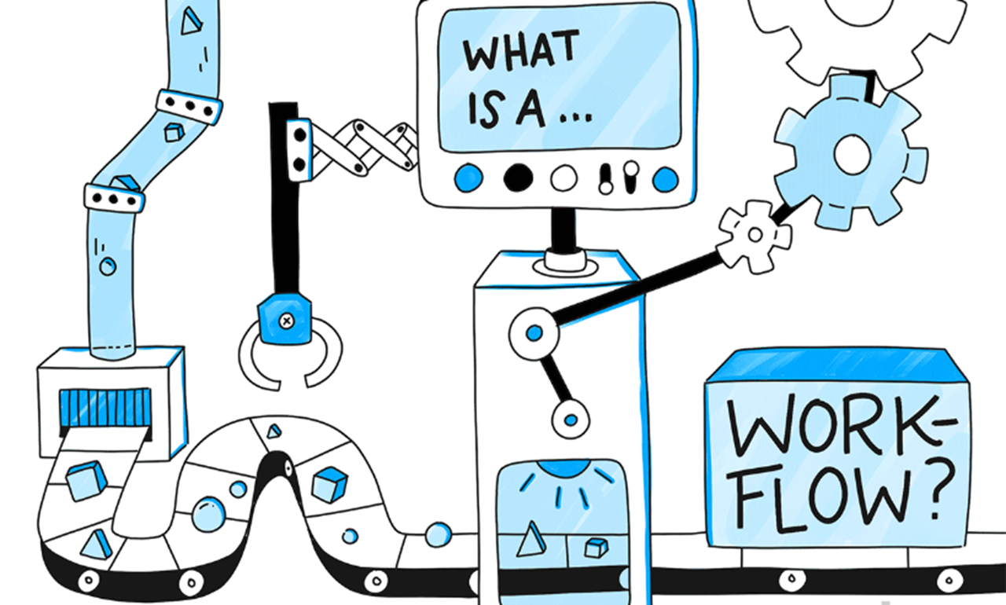
Value Stream Mapping
Notes:
The second Lean principle is identifying and mapping the value stream. In this step, the goal is to use the customer’s value as a reference point and identify all the activities that contribute to these values. Activities that do not add value to the end customer are considered waste. The waste can be broken into two categories: non-valued added but necessary and non-value & unnecessary. The later is pure waste and should be eliminated while the former should be reduced as much as possible. By reducing and eliminating unnecessary processes or steps, you can ensure that customers are getting exactly what they want while at the same time reducing the cost of producing that product or service.

Slide 14
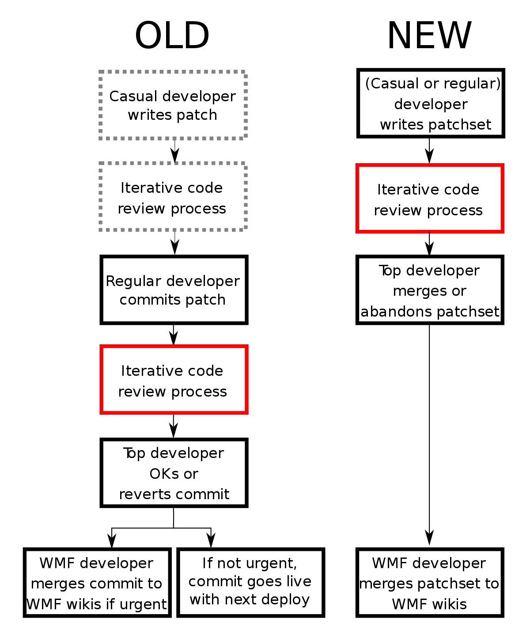
Create Continuous Workflow
breaking down steps
reconfiguring the production steps
leveling out the workload
creating cross-functional departments
training employees to be multi-skilled and adaptive
generic example
Notes:
After removing the wastes from the value stream, the following action is to ensure that the flow of the remaining steps run smoothly without interruptions or delays.

Slide 15
Establish Pull
Notes:
Inventory is considered one of the biggest wastes in any production system. The goal of a pull-based system is to limit inventory and work in process (WIP) items while ensuring that the requisite materials and information are available for a smooth flow of work. In other words, a pull-based system allows for Just-in-time delivery and manufacturing where products are created at the time that they are needed and in just the quantities needed. Pull-based systems are always created from the needs of the end customers. By following the value stream and working backwards through the production system, you can ensure that the products produced will be able to satisfy the needs of customers.

Slide 16
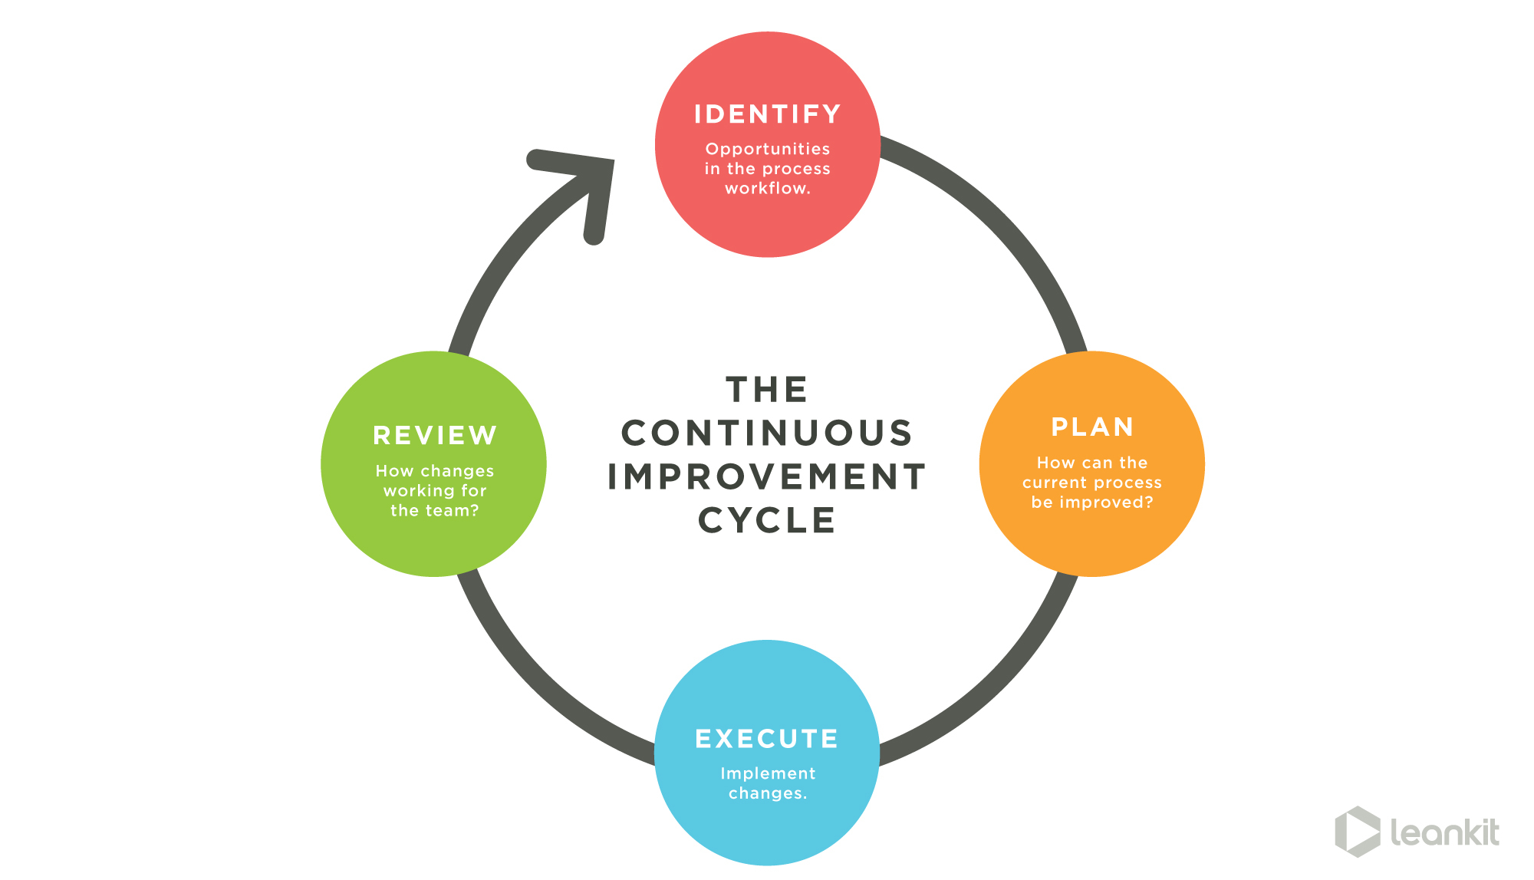
Continuous Improvement
Notes:
Wastes are prevented through the achievement of the first four steps: 1) identifying value, 2) mapping value stream, 3) creating flow, and 4) adopting a pull system. However, the fifth step of pursuing perfection is the most important among them all. It makes Lean thinking and continuous process improvement a part of the organizational culture. Every employee should strive towards perfection while delivering products based on the customer needs. The company should be a learning organization and always find ways to get a little better each and every day.

Slide 17
Other Key Concepts

Slide 18
Plan Do Check Act
Notes:
Define the target: What do you want to achieve? What are your goals?
Analyze the situation: Try to understand what the current situation is. Talk to people. Visit the shop floor and observe (Genchi Genbutsu). Collect data.
This is the actual implementation. Change the shop floor, create the product, actually make it happen. In all likelihood you will encounter additional problems during the Do that you did not think of before. That is normal. Just solve them as they come along.
This is probably the most frequently overlooked part of the PDCA. Did your implemented solution actually work? Did you achieve your goals? This is a very serious question. Judging from my experience, in most cases it does not, or at least not well enough.
The Act is to decide what to do next. This depends on the outcome of the Check. If your implementation failed to achieve the targets, you have to find out the reason. Why did your solution fail to perform as you expected? This will lead to a repetition of the PDCA with another Plan to figure out a new or better solution to achieve your goals.

Slide 19
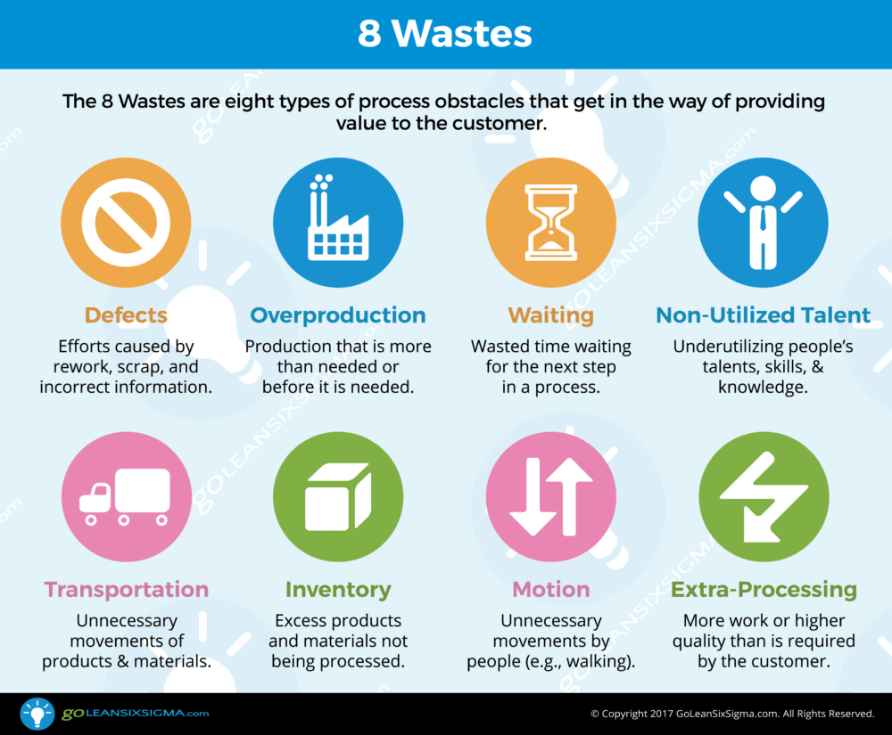

Slide 20
Poka-yoke
Detection
after Mistake
Prevention
Detect In Process
Eliminate at the source
Catch before problematic
Detect before next step

Slide 21
Case studies in-lab perspective
Annie Carter – Brooks Applied Labs

Slide 22
Case studies in-lab perspective
Jake Vanderboom – Pace Analytical Services, LLC

Slide 23
Q&A

